Slide 1
Lecture 21
Nick Rugai PhD

Slide 2
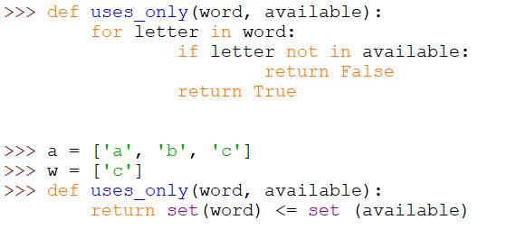
Sets
Check whether all letters in word are in available.

Slide 3
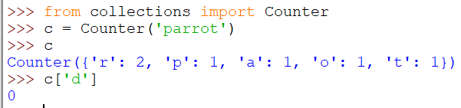

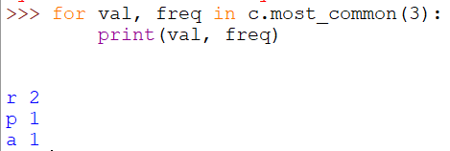

Counters
A counter is like a set but when an element appears more than once, the Counter keeps track of it. Counters need to be imported!
Unlike dictionaries, Counters do not raise an exception if an element does not exist.

Slide 4
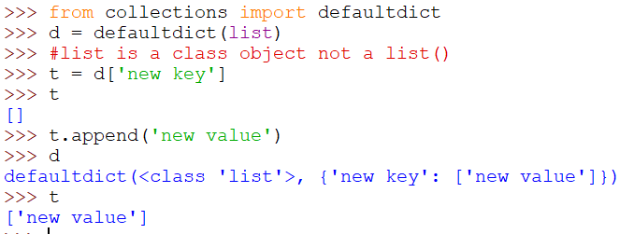
defaultdict
A defaultdict is a dictionary in where if a key does not exist, it can be created on the fly (it must be imported!):

Slide 5
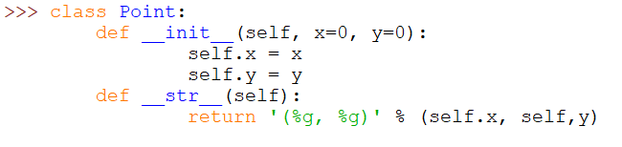
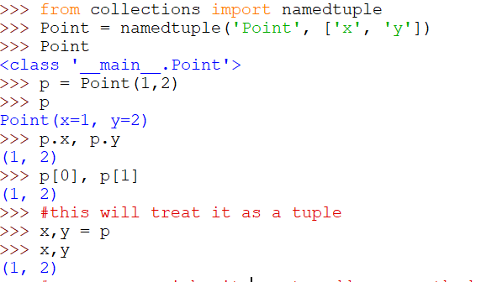
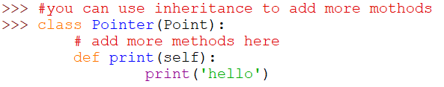
namedtuples

Slide 6
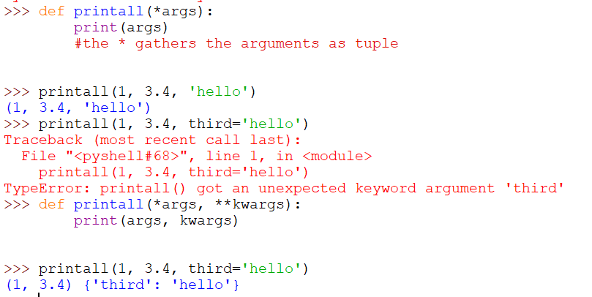
Gathering keyword arguments

Slide 7
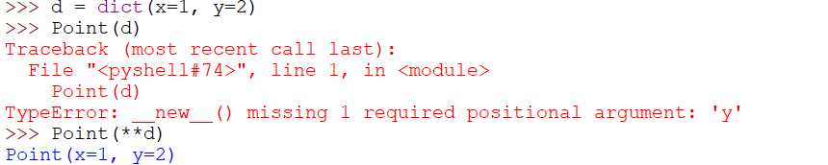
Gathering keyword arguments

Slide 8
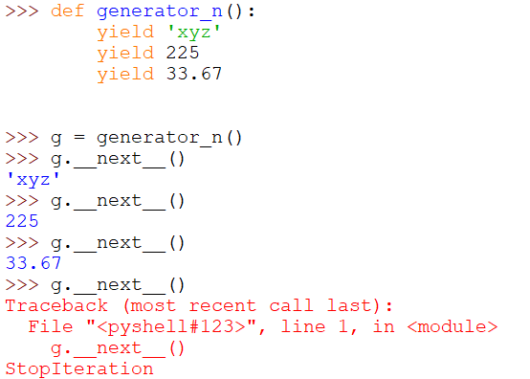
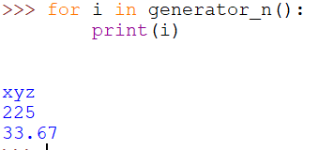
yield

Slide 9
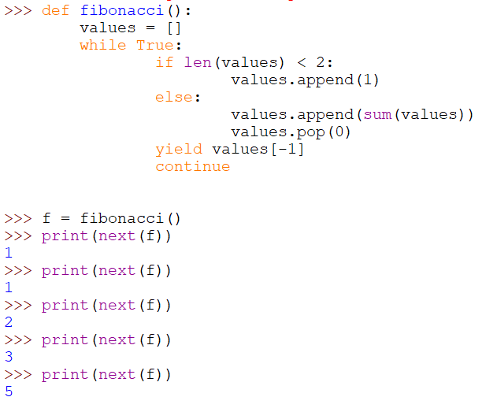
Using yield to rewrite Fibonacci #

Slide 10
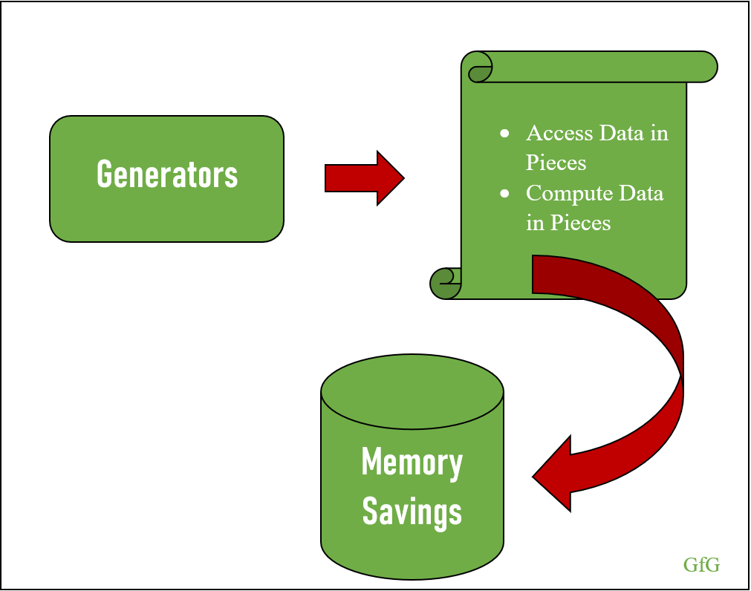
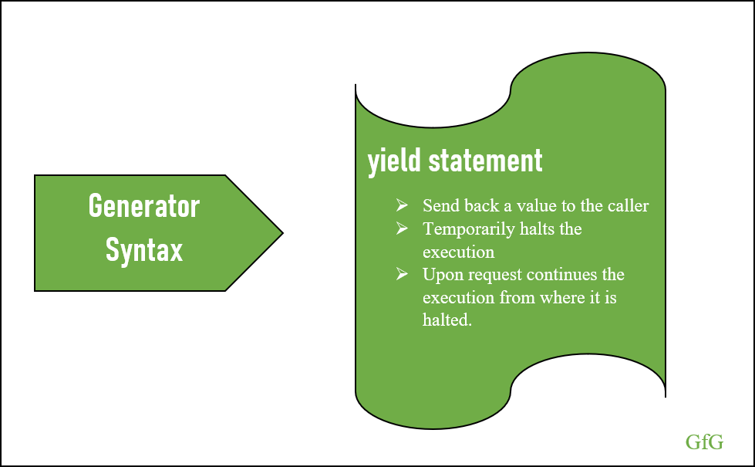
Generators Sum up

